Slide 1
Azure Reference Architecture Quizzes
By AltoTech

Slide 2
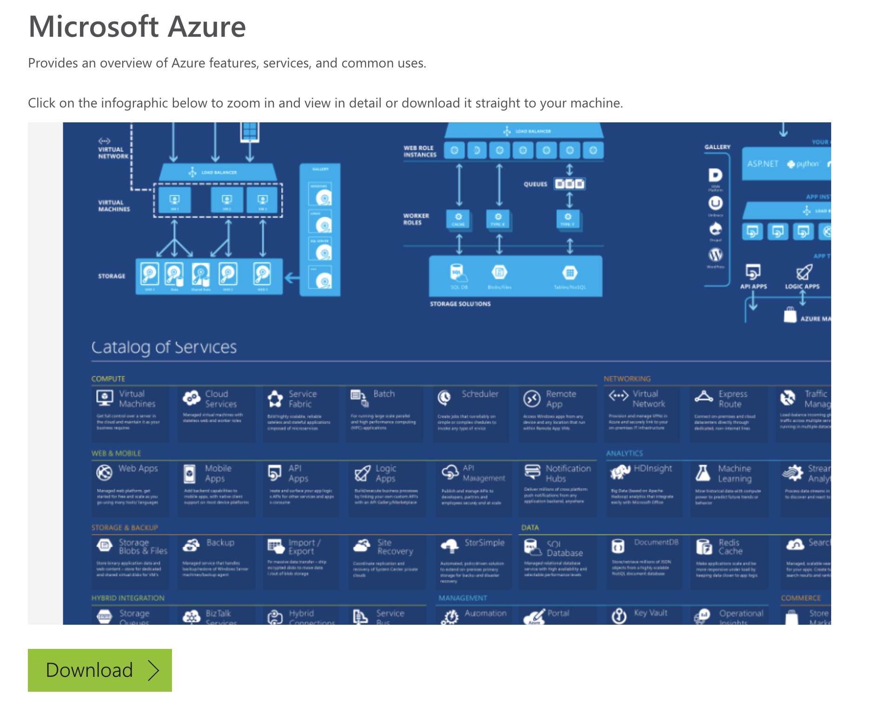
Download Infographic of Azure Reference Architecture
https://azure.microsoft.com/en-us/resources/infographics/azure/

Slide 3
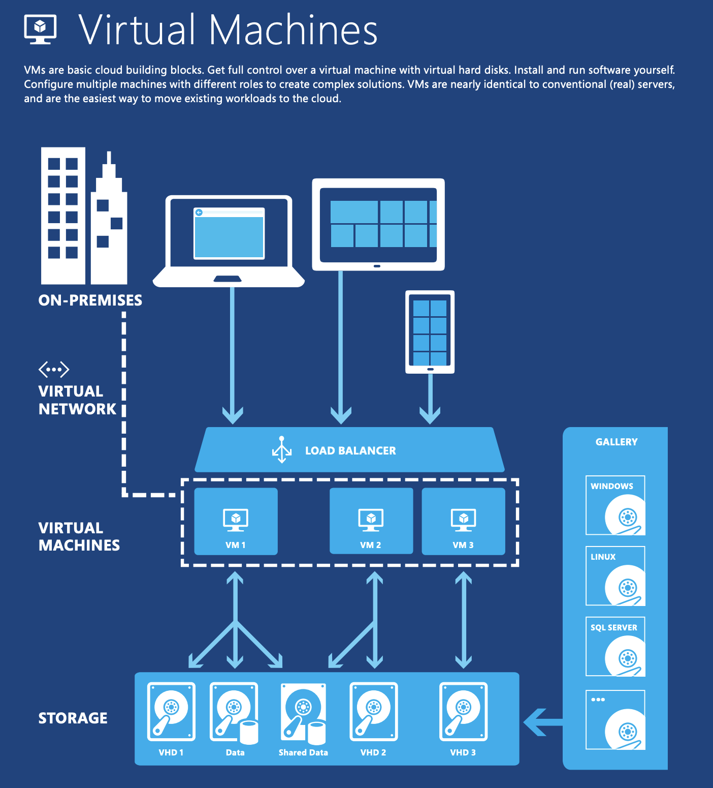
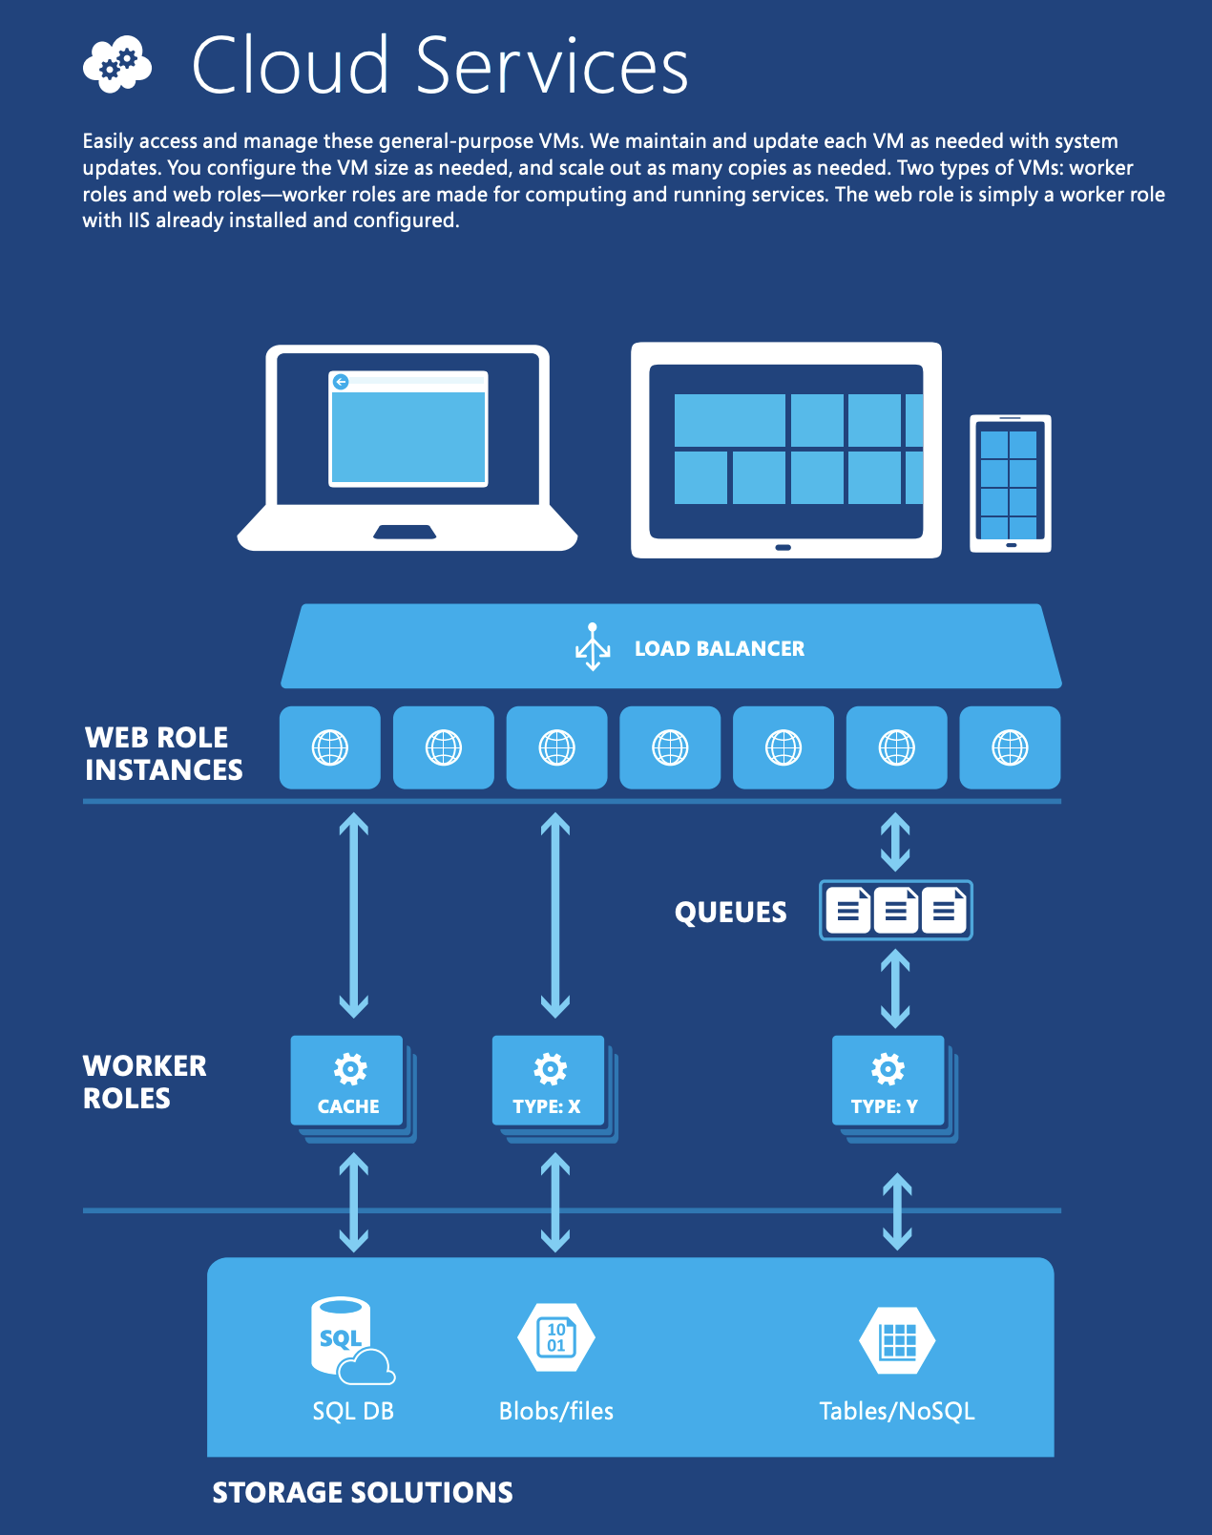
Download Infographic of Azure Reference Architecture

Slide 4
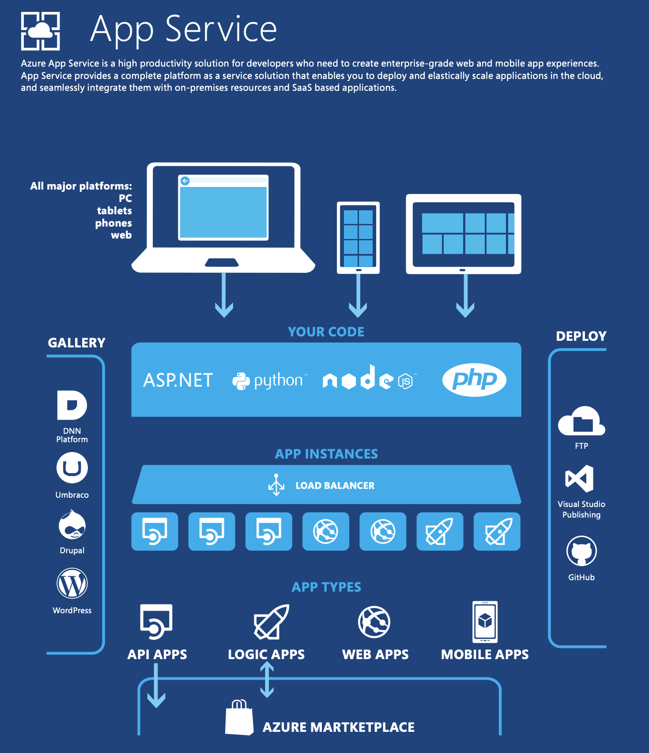
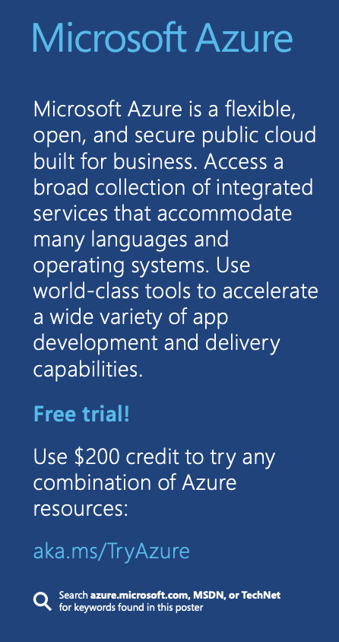
Download Infographic of Azure Reference Architecture

Slide 5
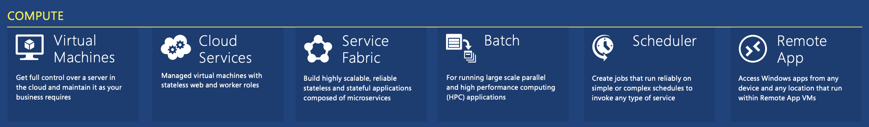
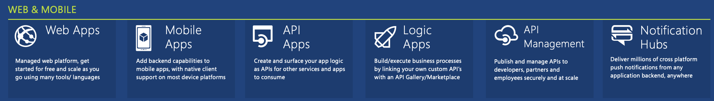
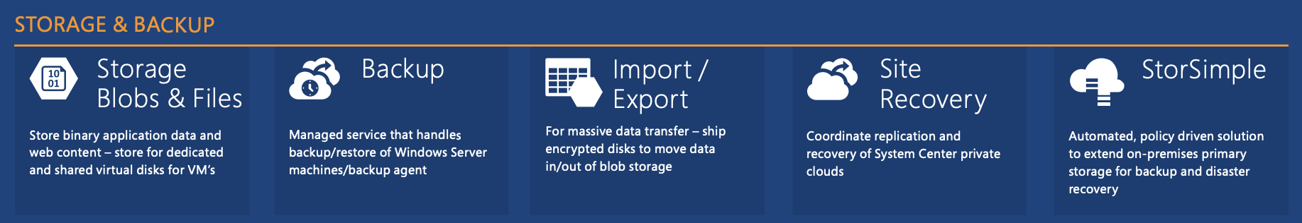
Download Infographic of Azure Reference Architecture

Slide 6
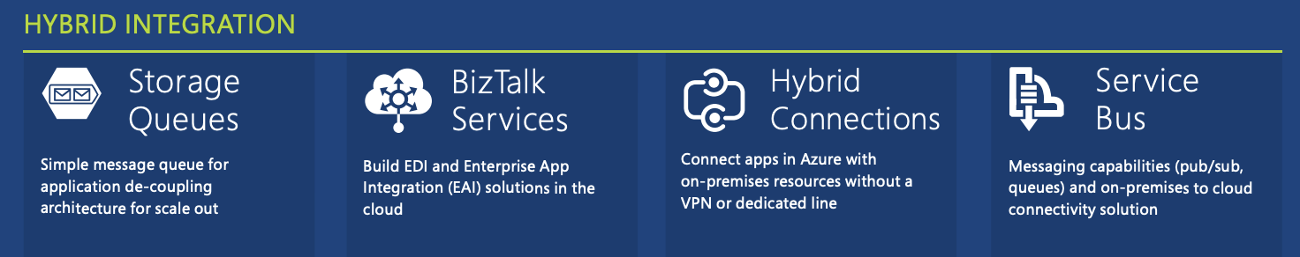
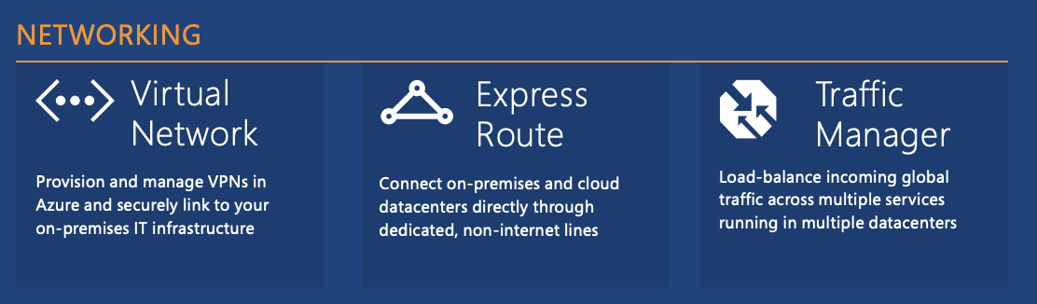
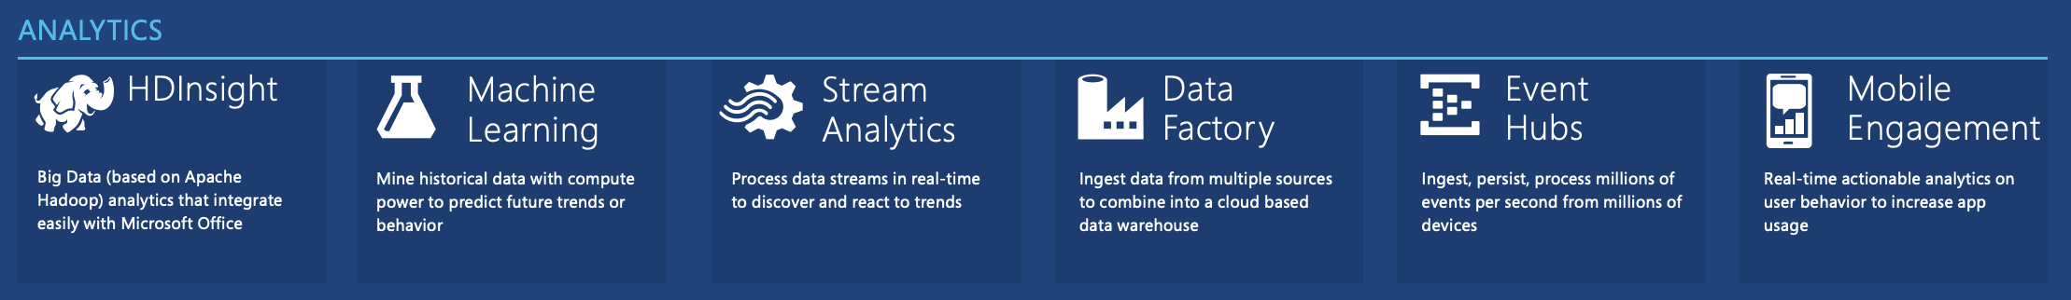
Download Infographic of Azure Reference Architecture

Slide 7
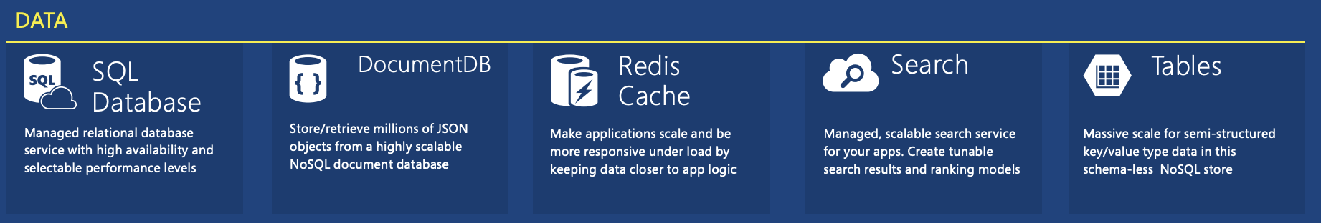
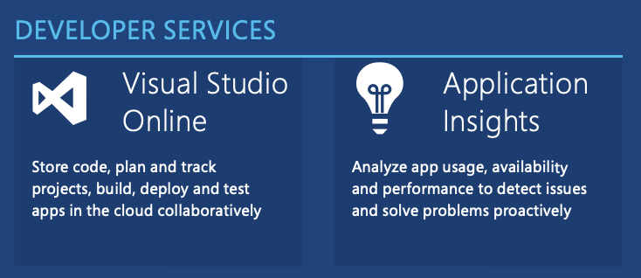
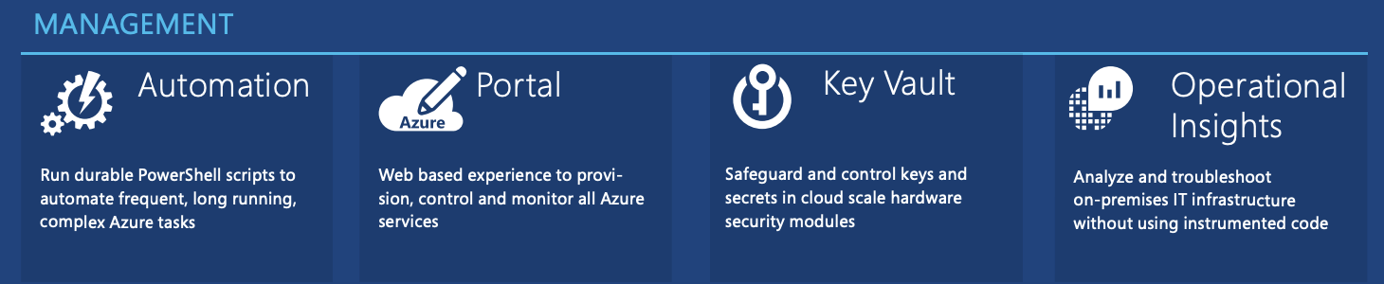
Download Infographic of Azure Reference Architecture

Slide 8
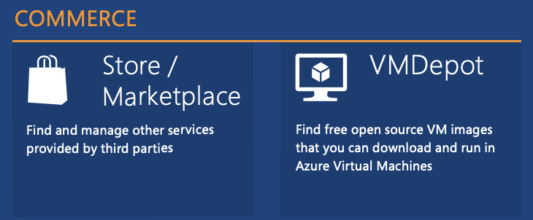
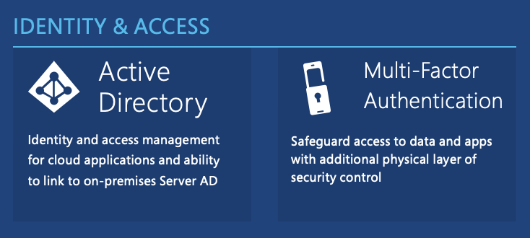
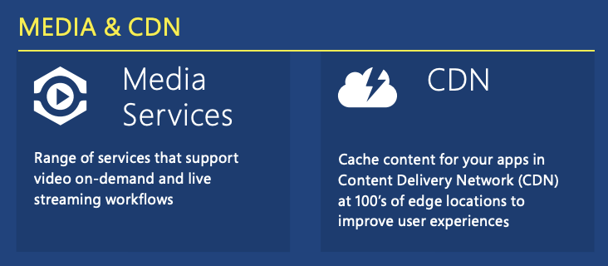
Download Infographic of Azure Reference Architecture

Slide 9
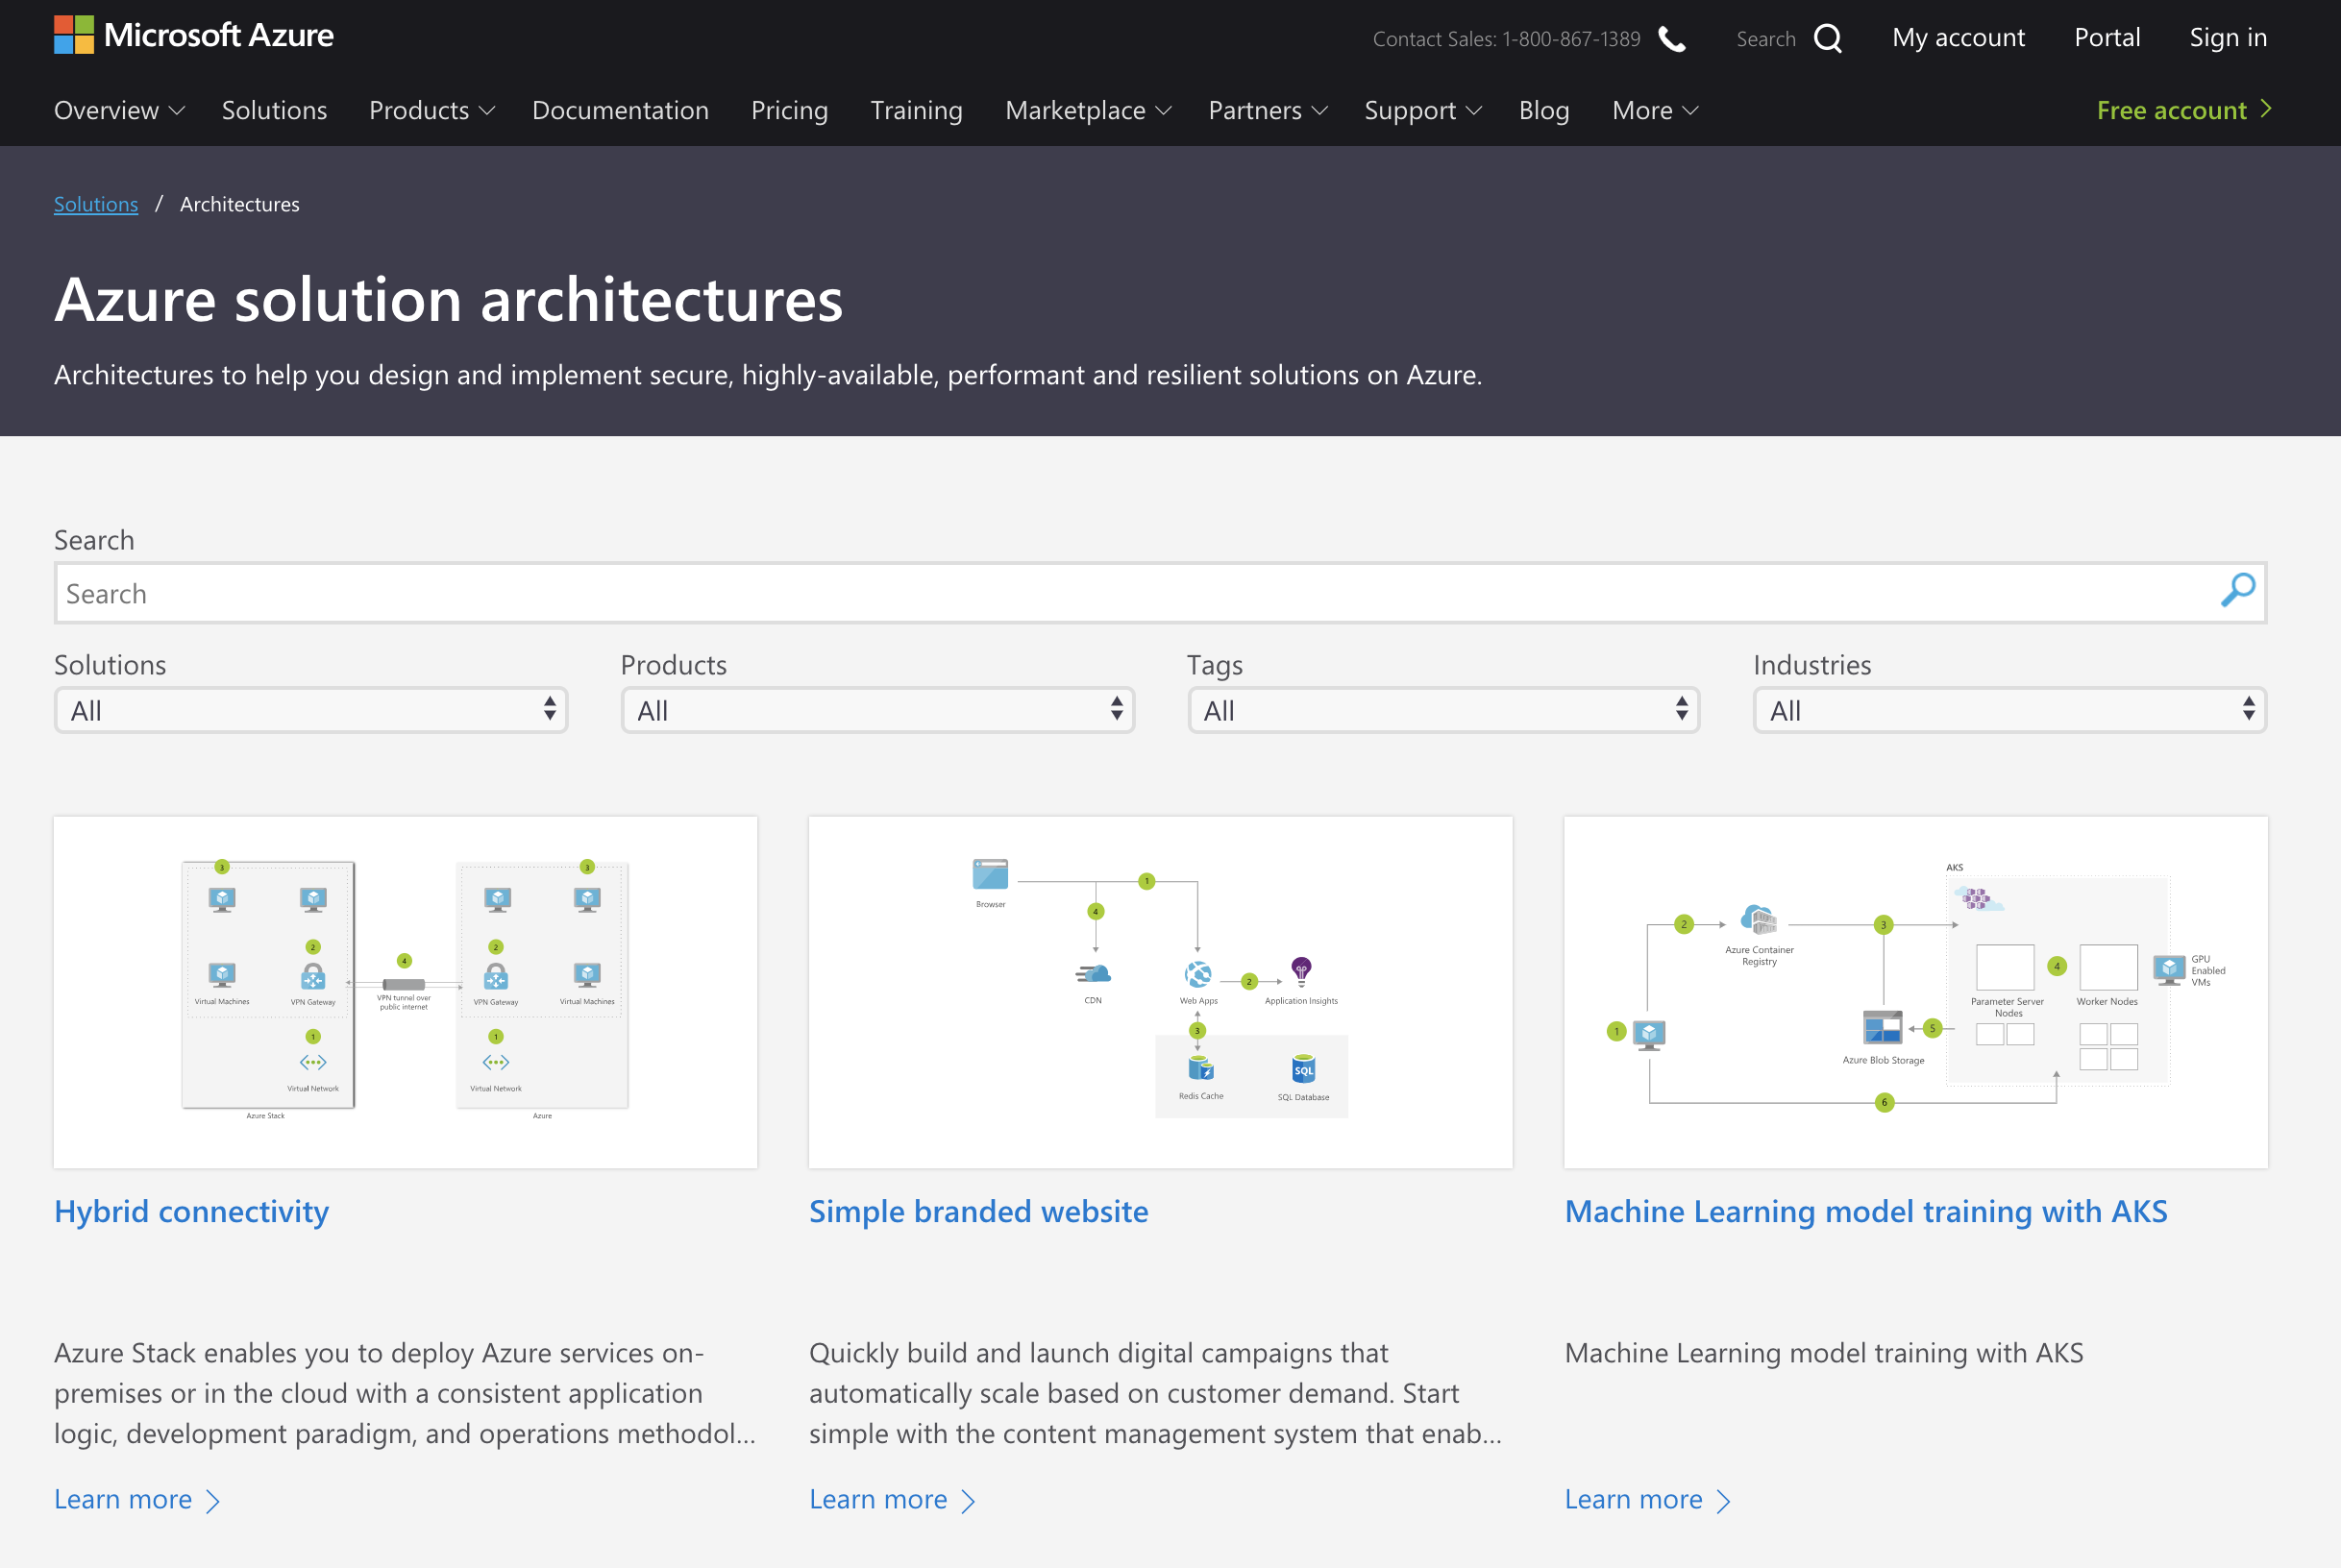
More References at Azure Solution Architecture:
https://azure.microsoft.com/en-us/solutions/architecture/

Slide 10
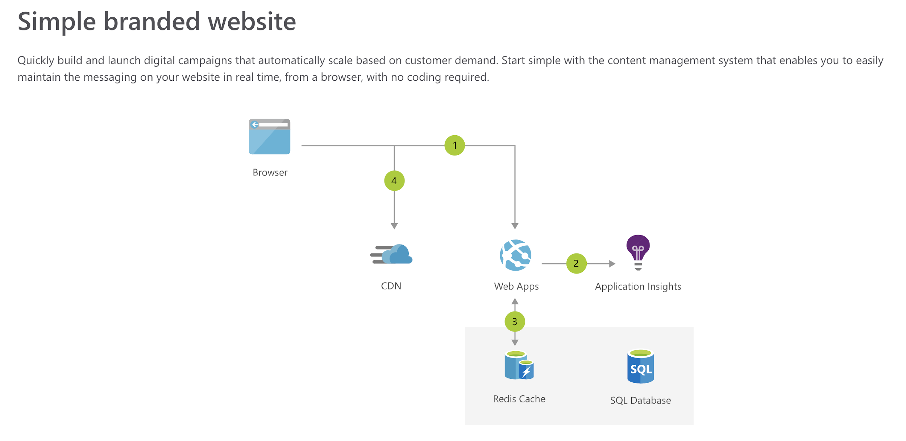





Quiz 1: Simple Branded Website
Instruction
1. User accesses Web Apps from ….… in a browser
2. …..... detects issues and analyzes usage for your web apps.
3. Web App connects to ... and …….for better performance.
4. Browser pulls static resources such as video from ...… Network to reduce load time.
Web App
CDN
Application Insights
Redis Cache
SQL Database

Slide 11
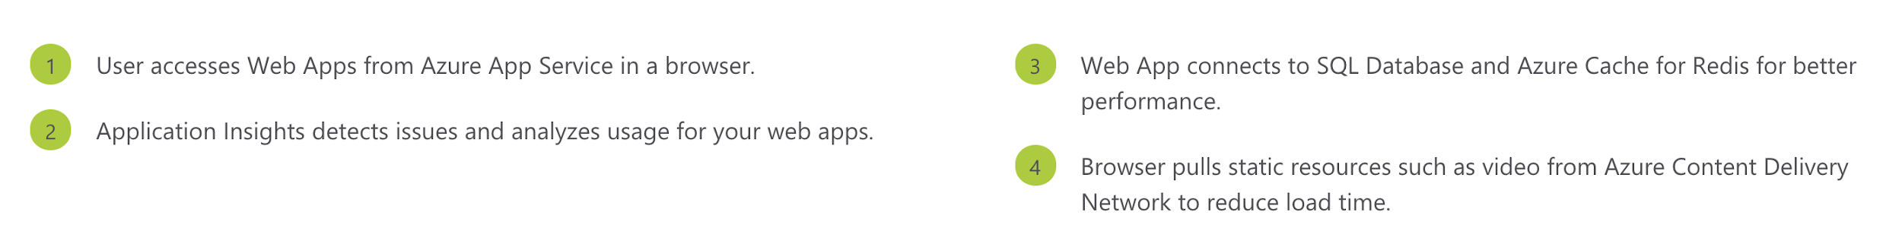
Ans1: Simple Branded Website

Slide 12
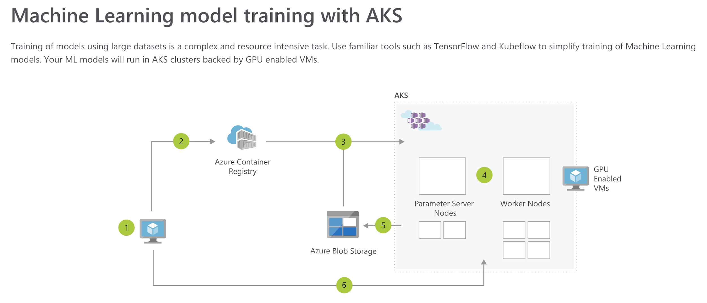
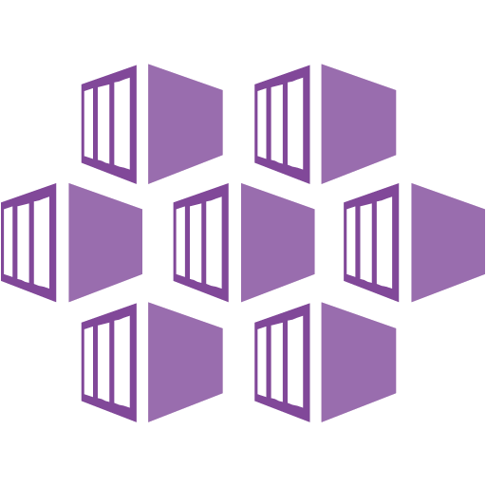

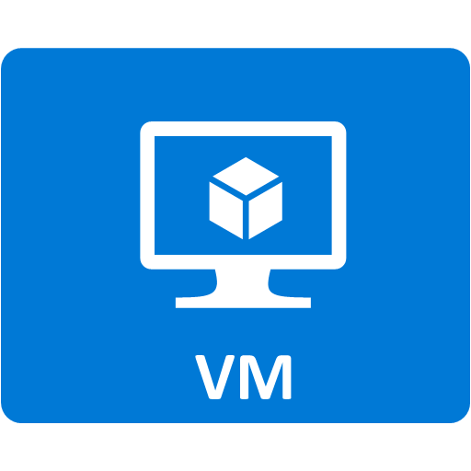

Quiz 2: Simple Branded Website
Instruction
1. Data scientist builds ML Model (or uses a publicly available model).
2. Data scientist publishes model and pushed image to the ..2..
3. Training dataset is loaded into Azure files and training job is deployed to .3..
4. Distributed training job to AKS includes Parameter servers and Worker nodes on …4..
5. Trained model is stored in ..5..
6. The data scientist introspects the training using TensorBoard deployed by Kubeflow.
Azure Blob Storage
Azure Container Service
GPU Enabled VMs
Azure Container Registry

Slide 13
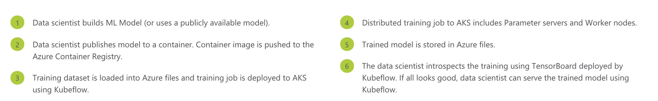
Ans2: Simple Branded Website

Slide 14
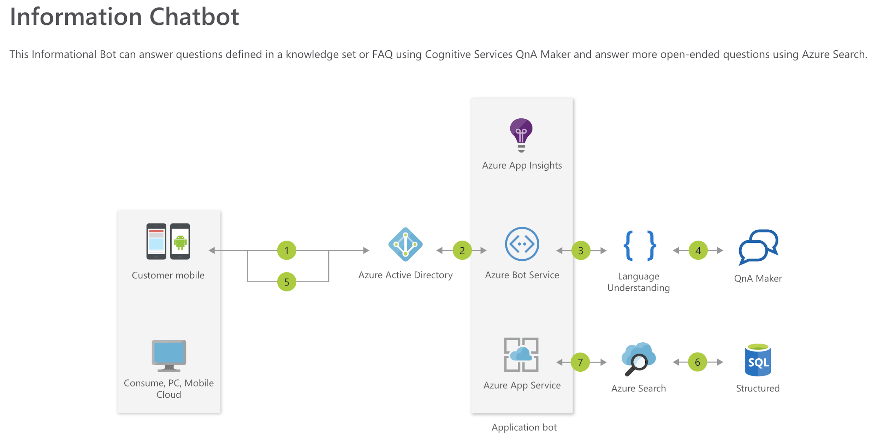





Quiz 3: Information Chatbot
Active Directory
Bot service
Language Understanding
Azure Search
SQL Database
Azure App Service
Application Insights

Slide 15
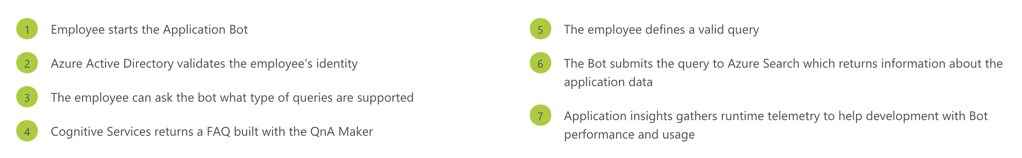
Ans3: Information Chatbot

